Slide 1
your
name

Slide 2
Topics Covered in this Proposal
Project Description and Benefit
Giving Leadership
Materials
Supplies
Tools
Permits and Permissions
Preliminary Cost Estimate
Funding
Project Phases
Logistics
Safety Issues
Further Planning

Slide 3
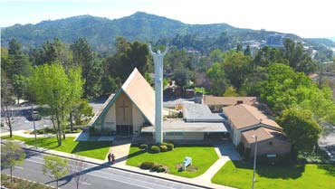
Project Description and Benefit
Beneficiary
Lutheran Church in the Foothills
1700 Foothill Blvd., La Canada Flintridge 91011

Slide 4
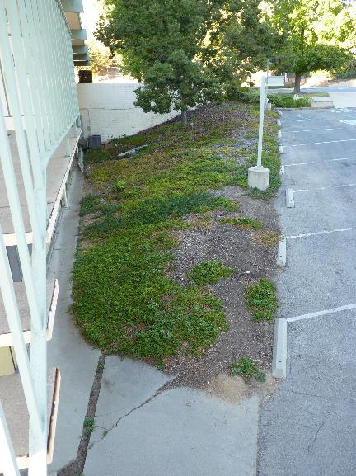
Project Description and Benefit
Project Description
Re-landscape a 2,000 sq. ft. slope between the church and parking lot

Slide 5
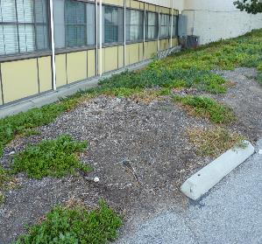
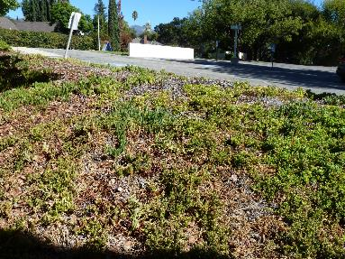
Project Description and Benefit
Current landscape dates from 1950s when church was built
Originally covered with ice plant and had sprinklers
Irrigation has been non-functional for decades

Slide 6
Project Description and Benefit
I will:
Strip the area of vegetation
Dig up old irrigation lines
Install new irrigation lines with sprinkler heads on two new valves
Use the existing red apple plants to replant across the entire area with 3-ft spacing
Finish by covering area with 2” mulch

Slide 7
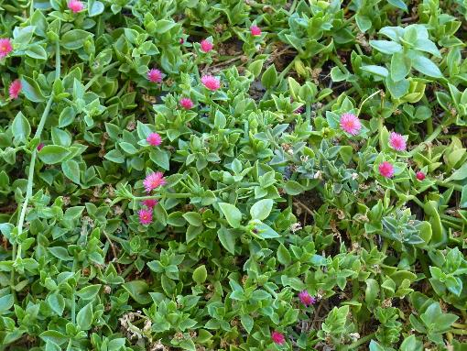
Project Description and Benefit
Red apple is a relative of ice plant that spreads well and is green year-round. It absorbs water through its leaves so prefers light but frequent watering.

Slide 8
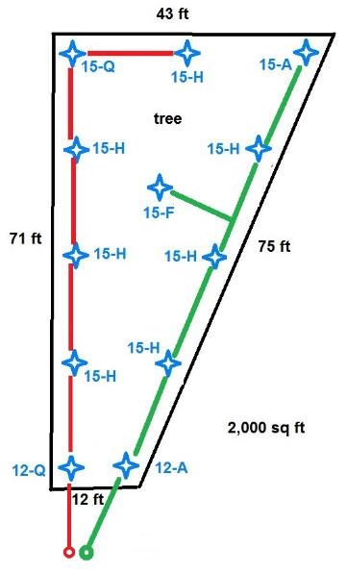
Project Description and Benefit
2 Valves
12 Sprinkler Heads
15-ft radius
1 full, 7 half, 1 quarter, 1 adjustable
12-ft radius
1 quarter, 1 adjustable

Slide 9
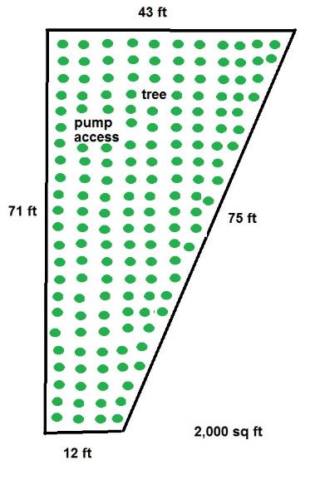
Project Description and Benefit
180 red apple plants
will propagate from stem cuttings

Slide 10
Giving Leadership
2 Work Days
In December to install irrigation
need 4-6 helpers, ages 15+
will recruit from church youth group
exact date depends on when ready to install
In January to plant and mulch
need 6-10 helpers, ages 11+
will recruit from troop
will avoid holiday weekends

Slide 11
Giving Leadership
Will use the Patrol Method
Divide helpers into teams, each with a team leader
Will use the EDGE Method
Explain, Demonstrate, Guide & Enable the team leaders
Team leaders use EDGE with their teams
I supervise and empower the team leaders

Slide 12
Materials
2 anti-siphon valves 3/4”
220 ft PVC pipe 3/4”
12 tees, risers & sprinkler heads
fittings – couplings, elbows, caps
180 red apple plants
37 cubic yds mulch

Slide 13
Supplies
PVC pipe cement
thread seal tape
gloves
first aid kit
water
snacks
lunch

Slide 14
Tools
When clearing and preparing land
shovels
rakes
wheelbarrow
When installing irrigation
measuring tape
PVC pipe cutter
file
When planting and mulching
trowels
buckets

Slide 15
Permits and Permissions
Already have permission of church council
No building permit required by city

Slide 16
Preliminary Cost Estimate
$50 anti-siphon valves
$50 PVC pipe
$25 tees
$15 risers
$25 sprinkler heads
$7 fittings
$0 plants
$75 mulch
$6 pipe cement
$2 thread seal tape
$0 water, snacks & lunch
$255 total

Slide 17
Funding
Have consent from church council to solicit donations from congregation
Getting 15% discount from Landscape Warehouse in Altadena
Fundraiser at Habit Burger if necessary
Personal savings if necessary
Parents if necessary

Slide 18
Project Phases
Planning and Approvals 26 hrs
Clear and Prepare Land 25 hrs
Install Irrigation 23 hrs
Plant and Mulch 20 hrs
Project Completion 7 hrs
Total 101 hrs

Slide 19
Project Phases
1. Planning and Approvals
Investigate feasibility 3 hrs
Estimate costs 3 hrs
Prepare proposal 10 hrs
Obtain approvals 3 hrs
Request donations 1 hr
Finalize plans 4 hrs
Buy materials & supplies 2 hrs
Total 26 hrs

Slide 20
Project Phases
2. Clear and Prepare Land
Collect red apple plants 3 hrs
Remove vegetation 10 hrs
Grade 2 hrs
Dig trenches 10 hrs
Total 25 hrs

Slide 21
Project Phases
3. Install Irrigation
Connect valves to water line 2 hrs
Connect valves to controller 2 hrs
Lay & cement PVC 14 hrs
Screw on risers & sprinkler heads 2 hrs
Bury PVC 2 hrs
Test & adjust sprinklers 1 hr
Total 23 hrs

Slide 22
Project Phases
4. Plant and Mulch
Dig holes & plant red apple plants 14 hrs
Put mulch between plants 6 hrs
Total 20 hrs

Slide 23
Project Phases
5. Project Completion
Get project completion approved 1 hr
Prepare final report 6 hrs
Total 7 hrs

Slide 24
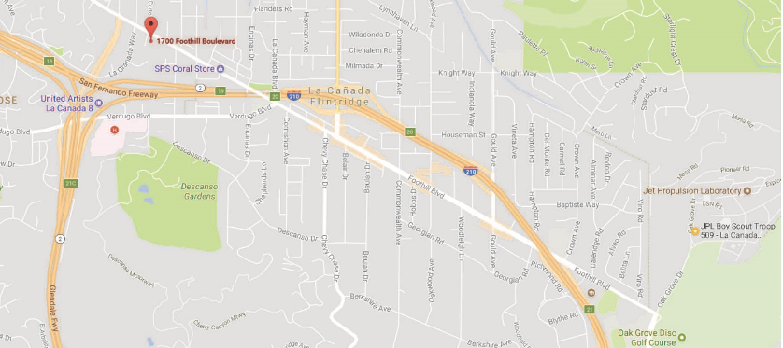
Logistics
Since project is in LCF, no transportation to site will be provided to helpers
Church has bathrooms and dumpster
Materials will be transported by parents’ car

Slide 25
Safety
Will Follow Guide to Safe Scouting
Chapter V. Medical Information and First Aid
Appendix. Service Project Planning Guidelines
Hazard Analysis and Recognition
List possible hazards
Consider the weather
Monitor tool usage
Prepare for emergencies
Appendix. Age Guidelines for Tool Use and Work at Elevations or Excavations

Slide 26
Safety
Sweet Sixteen of BSA Safety
Qualified Supervision
Physical Fitness
Buddy System
Safe Area or Course
Equipment Selection and Maintenance
Personal Safety Equipment
Safety Procedures and Policies
Skill Level Limits
Weather Check
Planning
Communications
Plans and Notices
First-aid Resources
Applicable Laws
CPR Resource
Discipline

Slide 27
Safety
A First Aid Kit will be on-site at all times
Sunscreen & water will always be available
Closed shoes required, but shorts okay
No heavy objects are expected, but if any, will be limited to adults and older scouts
No power tools are expected, but if any, will be limited to adults

Slide 28
Safety
Nearest Emergency Room
0.6 mile from church
USC Verdugo Hills Hospital
1812 Verdugo Blvd.
Glendale, CA 91208
(also, fire station 19 is across Foothill from the church)

Slide 29
Further Planning
Need to do more planning for propagating red apple plants
Will contact some bulk suppliers to see if they could donate the 37 cubic yds of mulch I need
Create recruitment flyer
Prepare time sheets
Make snack and lunch arrangements

Slide 30
Questions / Comments ?
Thank You for Your
Time and Attention

Slide 31
your name

